Slide 1
Morehouse College | StudyBuddy
Supreme Constantine, Amir Harris, Marlon Nurse, Beloved Joshua Simons, Fredrick Thornton

Slide 2
Introduction & Agenda
User Stories
Product Backlog
System Design
Testing Strategy
CI/CD & DevOps Plan
RACI Summary
Reflections

Slide 3
User Stories
Group Management
As a student, I want to create a study group for a specific subject so that I can collaborate with peers.
As a student, I want to search for and request to join existing study groups so I can find help in subjects I’m struggling with.
As a group admin, I want to approve or reject join requests so I can manage who is in the group.
Scheduling
As a group member, I want to propose and vote on meeting times so we can find a time that works for everyone.
As a group member, I want to see upcoming study sessions in a calendar view so I can plan my schedule.
Collaboration
As a group member, I want to share notes, links, and documents so we can study more effectively together.
As a group member, I want to comment on shared materials so we can discuss and clarify concepts.

Slide 4
Acceptance Criteria
"As a student, I want to create a study group..."
User can input group name, subject, and description.
User can set group visibility (public/private).
Group is created and visible in the group directory (if public).
"As a group member, I want to propose and vote..."
User can suggest multiple time slots.
Other members can vote on preferred times.
The most-voted time is automatically scheduled.
"As a group member, I want to share notes..."
User can upload files or paste text notes.
Notes are visible to all group members.
Notes can be edited or deleted by the author or group admin.

Slide 5
Product Backlog Table for StudyBuddy
Epic | User Story | Priority | Status
Group Management | As a student, I want to join subject based groups so I can study collaboratively. | High | Completed
Group Management | As a group admin, I want to approve or deny join request, so I can manage who joins. | High | Completed
Group Management | As a user, I want to schedule virtual/in-person sessions, so I can coordinate study times. | High | Completed
Collaboration Tools | As a student, I want to upload and view shared notes so I can understand how others process information | high | Completed
Collaboration Tools | As a user, I want to receive notifications when someone uploads new notes, so I can stay updated without constantly checking. | high | Completed

Slide 6
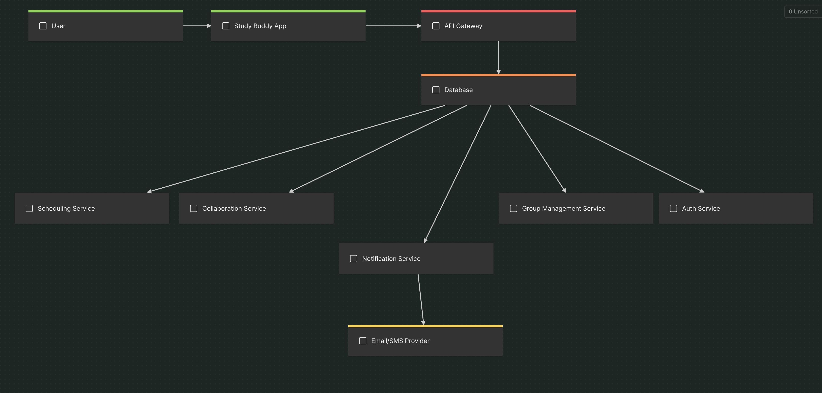
System Design

Slide 7
Testing Strategy

Slide 8
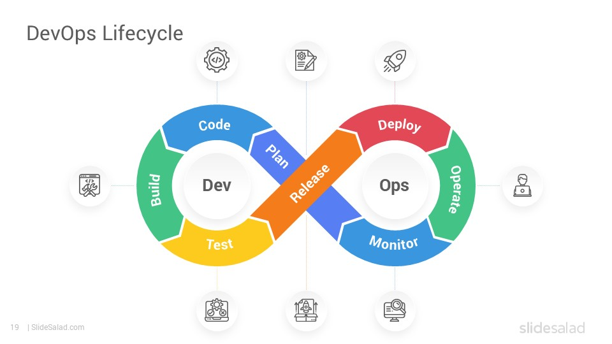
CI/CD & DevOps Plan
Deploy: After testing, the app is launched so real users (students and advisors) can start using StudyBuddy.
Operate: The team handles bug fixes, user issues, and app updates now that it’s live.
Monitor: The team keeps an eye on performance, crashes, and overall app health to make sure everything runs smoothly.
Plan: Sit down with StudyBuddy stakeholders and clarify what their goals for the app are
Code: Developers take the plan and turn it into a real product. They code features based on user stories, such as group search, session scheduling, and note-sharing.
Build: The code written by developers is turned into a working/complete version of the StudyBuddy app.
Test: The StudyBuddy app is tested for bugs or issues that would need to be fixed. Test if users can join groups, schedule sessions, and upload notes without any problems.
Integrate: All parts of the product (frontend, backend, API, database) are brought together and tested as a full system. New features get added into the full codebase so everything works together.

Slide 9
CI/CD & DevOps Plan
Phase | Process
Plan | Sit down with StudyBuddy stakeholders and clarify what their goals for the app are
Code | Developers take plan and turn it into a real product. They code features based on user stories, such as group search, session scheduling, and note-sharing.
Build | Turn all the code into a working version of the StudyBuddy app that’s ready for testing.
Test | The app is tested for bugs or issues. Test if users can join groups, schedule sessions, and upload notes without any problems.
Phase | Process
Integrate | Everything is brought together (frontend, backend, APIs, database) to make sure all parts of the app work together as one.
Deploy | After testing, the app is launched so real users (students and advisors) can start using StudyBuddy.
Operate | The team handles bug fixes, user issues, and app updates now that it’s live.
Monitor | The team keeps an eye on performance, crashes, and overall app health to make sure everything runs smoothly.

Slide 10
Team Collaboration Summary
Supreme Constantine | CI/CD Devops Plan | Slide 8 & 9
Amir Harris | Product Backlog Table | Slide 5
Marlon Nurse | User Stories & Acceptance Crit. | Slide 3 & 4
Beloved Joshua Simons | System Design Diagram Testing Strategy | Slide 6 & 7
Fredrick Thornton | User Stories Product Backlog | Deck Management Reflections

Slide 11
Reflections
Supreme Constantine
Amir Harris
Marlon Nurse
Beloved Joshua Simons
Fredrick Thornton

